Slide 1
Estimation
Chapter 9

Slide 2
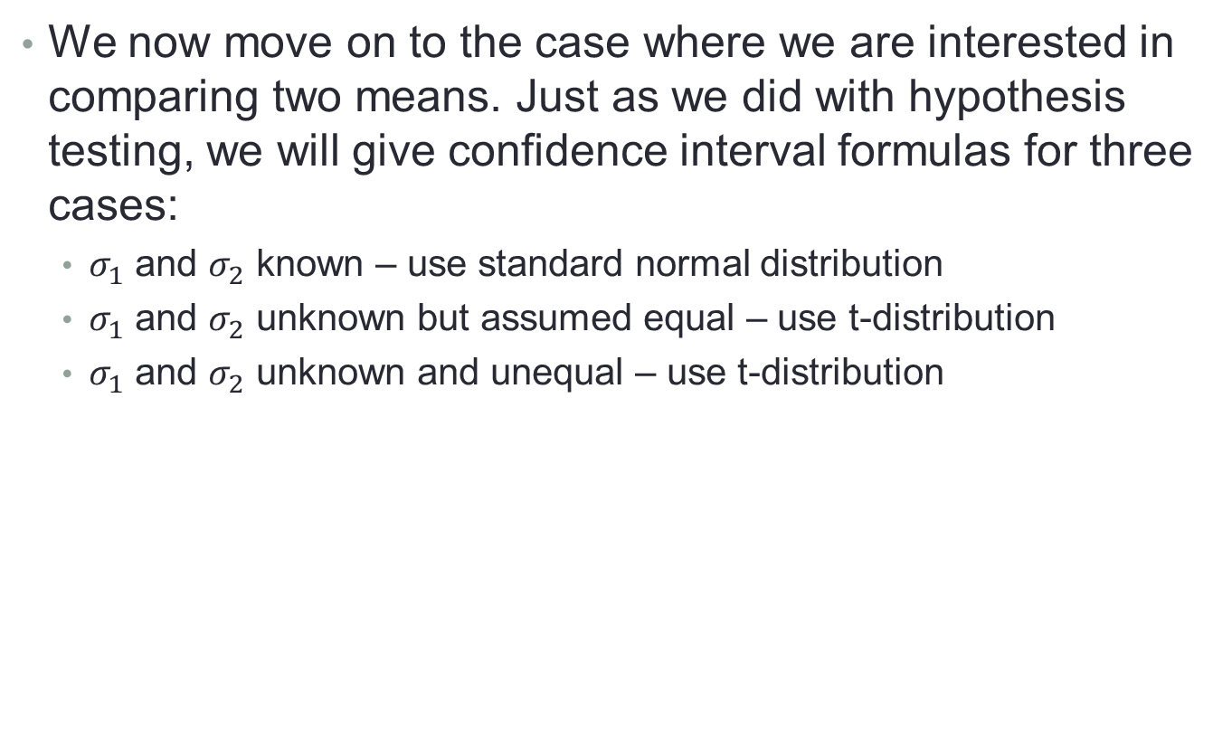
9.8 – Estimating the Difference between Two Means
We now move on to the case where we are interested in comparing two means. Just as we did with hypothesis testing, we will give confidence interval formulas for three cases:
  $σ_{1}$ and $σ_{2}$ known – use standard normal distribution
  $σ_{1}$ and $σ_{2}$ unknown but assumed equal – use t-distribution
  $σ_{1}$ and $σ_{2}$ unknown and unequal – use t-distribution

Slide 3
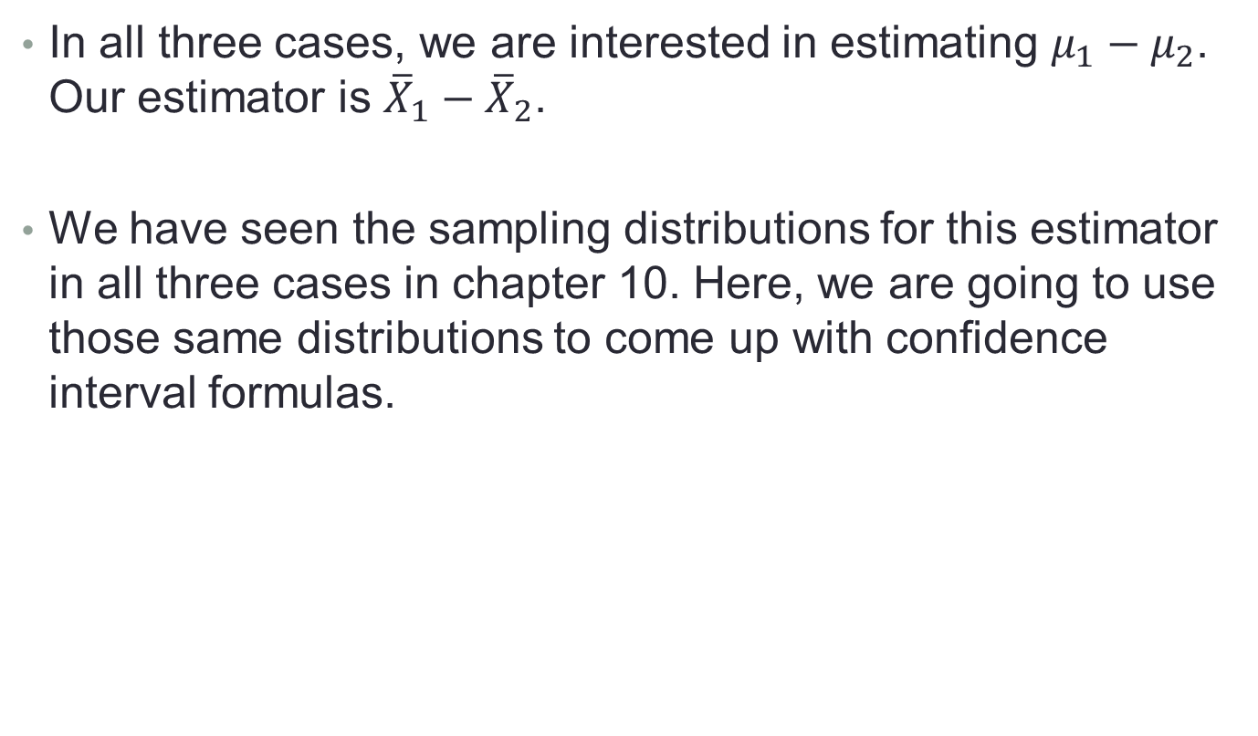
9.8 – Estimating the Difference between Two Means
In all three cases, we are interested in estimating $μ_{1}−μ_{2}$. Our estimator is ${\overline{X}}_{1}−{\overline{X}}_{2}$.
We have seen the sampling distributions for this estimator in all three cases in chapter 10. Here, we are going to use those same distributions to come up with confidence interval formulas.

Slide 4
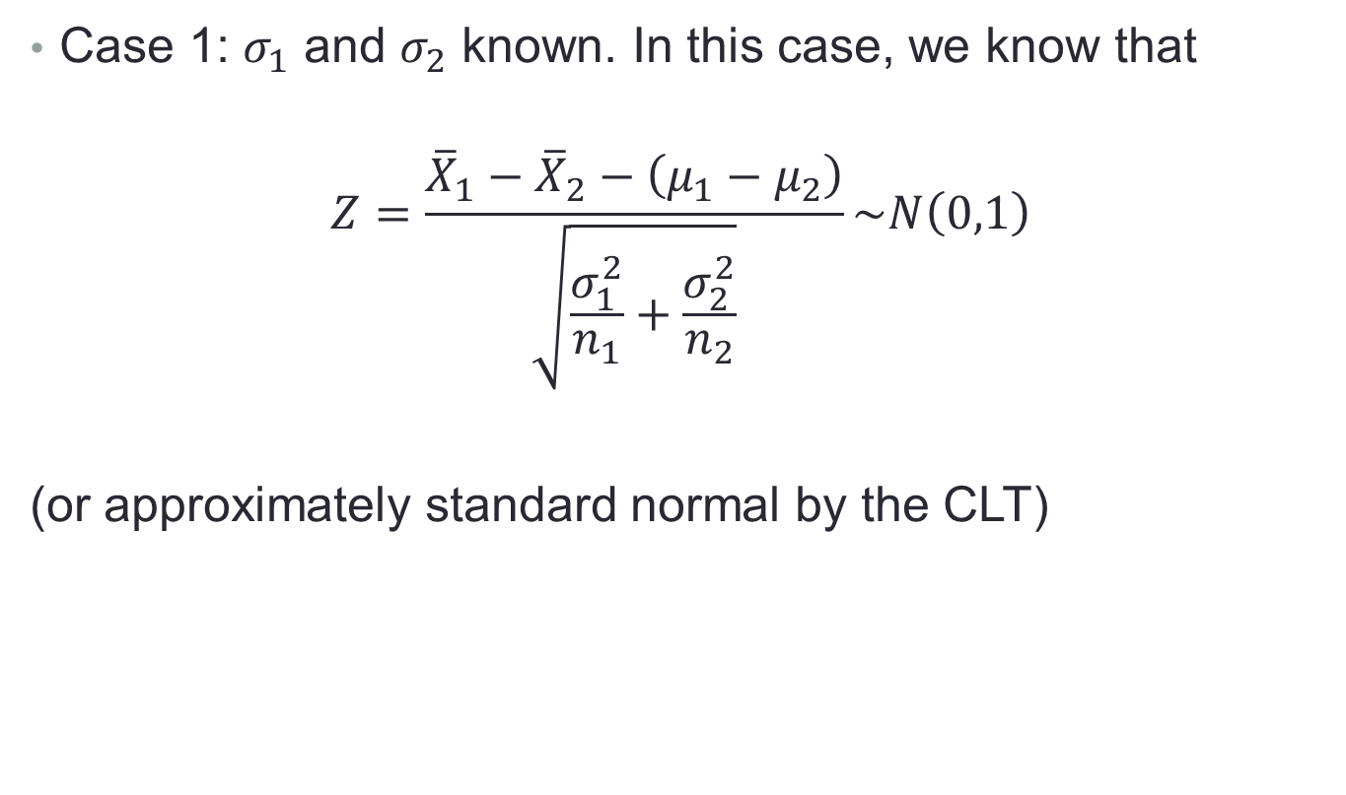
9.8 – Estimating the Difference between Two Means
Case 1: $σ_{1}$ and $σ_{2}$ known. In this case, we know that
$$Z=\frac{{\overline{X}}_{1}−{\overline{X}}_{2}−\left(μ_{1}−μ_{2}\right)}{\sqrt{\frac{σ_{1}^{2}}{n_{1}}+\frac{σ_{2}^{2}}{n_{2}}}}\sim N\left(0,1\right)$$
(or approximately standard normal by the CLT)

Slide 5
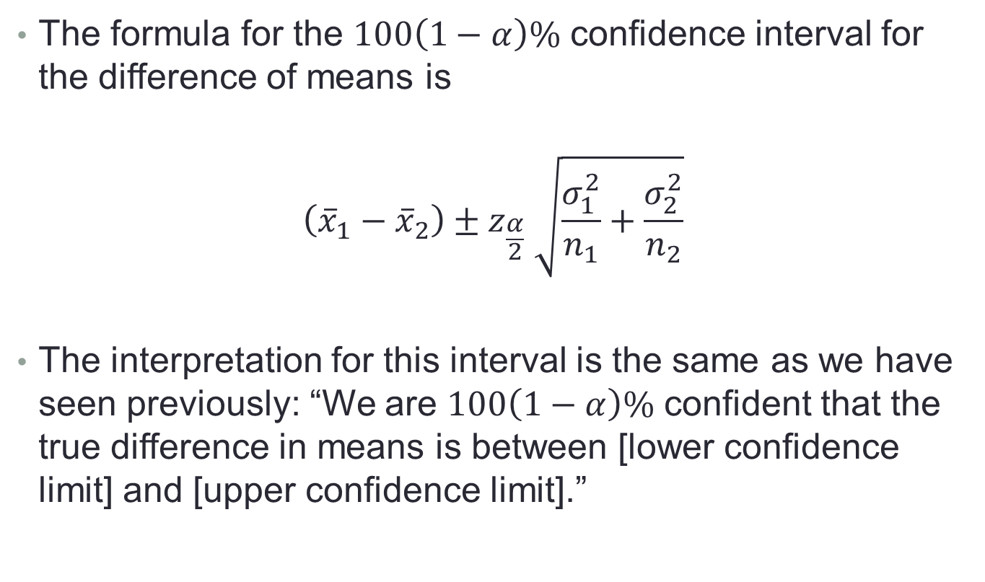
9.8 – Estimating the Difference between Two Means
The formula for the $100\left(1−α\right)\%$ confidence interval for the difference of means is
$$\left({\overline{x}}_{1}−{\overline{x}}_{2}\right)±z_{\frac{α}{2}} \sqrt{\frac{σ_{1}^{2}}{n_{1}}+\frac{σ_{2}^{2}}{n_{2}}}$$
The interpretation for this interval is the same as we have seen previously: “We are $100\left(1−α\right)\%$ confident that the true difference in means is between [lower confidence limit] and [upper confidence limit].”

Slide 6
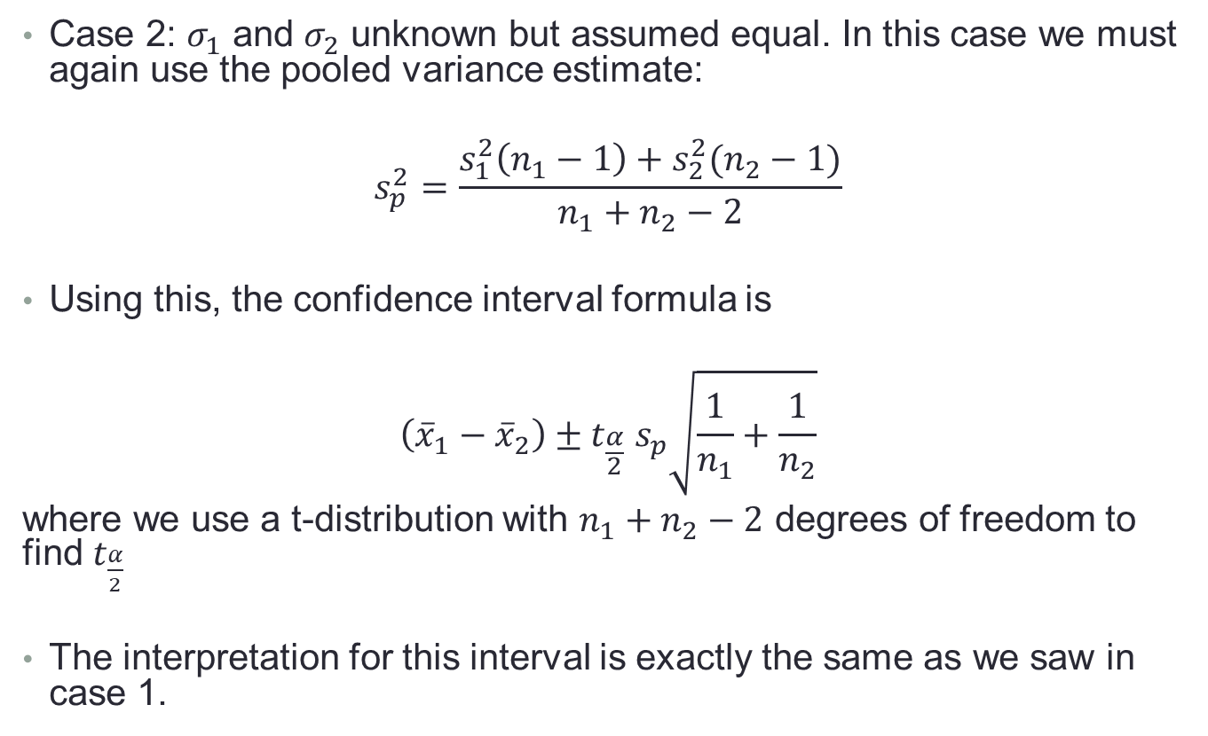
9.8 – Estimating the Difference between Two Means
Case 2: $σ_{1}$ and $σ_{2}$ unknown but assumed equal. In this case we must again use the pooled variance estimate:
$$s_{p}^{2}=\frac{s_{1}^{2}\left(n_{1}−1\right)+s_{2}^{2}(n_{2}−1)}{n_{1}+n_{2}−2}$$
Using this, the confidence interval formula is
$$\left({\overline{x}}_{1}−{\overline{x}}_{2}\right)±t_{\frac{α}{2}} s_{p}\sqrt{\frac{1}{n_{1}}+\frac{1}{n_{2}}}$$
where we use a t-distribution with $n_{1}+n_{2}−2$ degrees of freedom to find $t_{\frac{α}{2}}$
The interpretation for this interval is exactly the same as we saw in case 1.

Slide 7
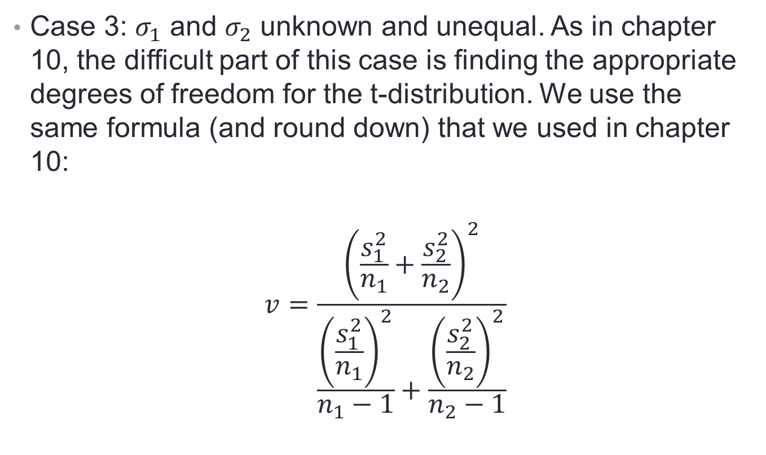
9.8 – Estimating the Difference between Two Means
Case 3: $σ_{1}$ and $σ_{2}$ unknown and unequal. As in chapter 10, the difficult part of this case is finding the appropriate degrees of freedom for the t-distribution. We use the same formula (and round down) that we used in chapter 10:
$$v=\frac{{\left(\frac{s_{1}^{2}}{n_{1}}+\frac{s_{2}^{2}}{n_{2}}\right)}^{2}}{\frac{{\left(\frac{s_{1}^{2}}{n_{1}}\right)}^{2}}{n_{1}−1}+\frac{{\left(\frac{s_{2}^{2}}{n_{2}}\right)}^{2}}{n_{2}−1}}$$

Slide 8
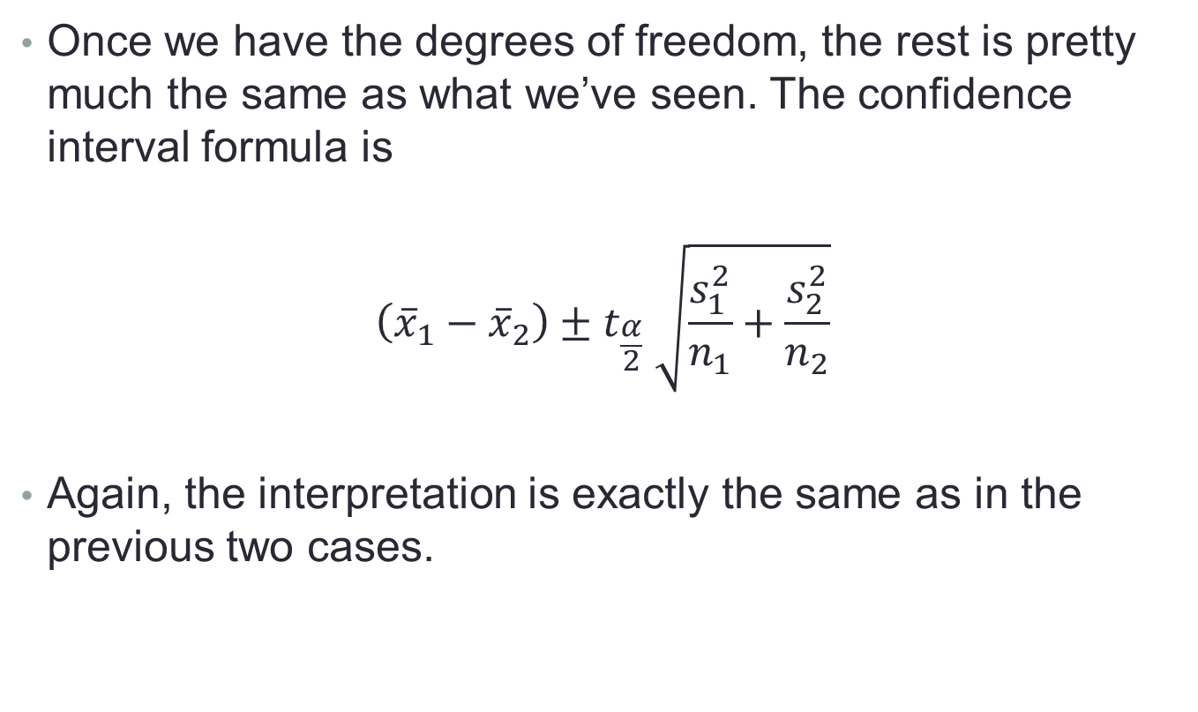
9.8 – Estimating the Difference between Two Means
Once we have the degrees of freedom, the rest is pretty much the same as what we’ve seen. The confidence interval formula is
$$\left({\overline{x}}_{1}−{\overline{x}}_{2}\right)±t_{\frac{α}{2}} \sqrt{\frac{s_{1}^{2}}{n_{1}}+\frac{s_{2}^{2}}{n_{2}}}$$
Again, the interpretation is exactly the same as in the previous two cases.

Slide 9
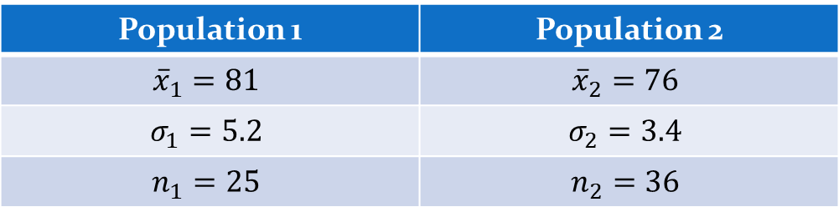
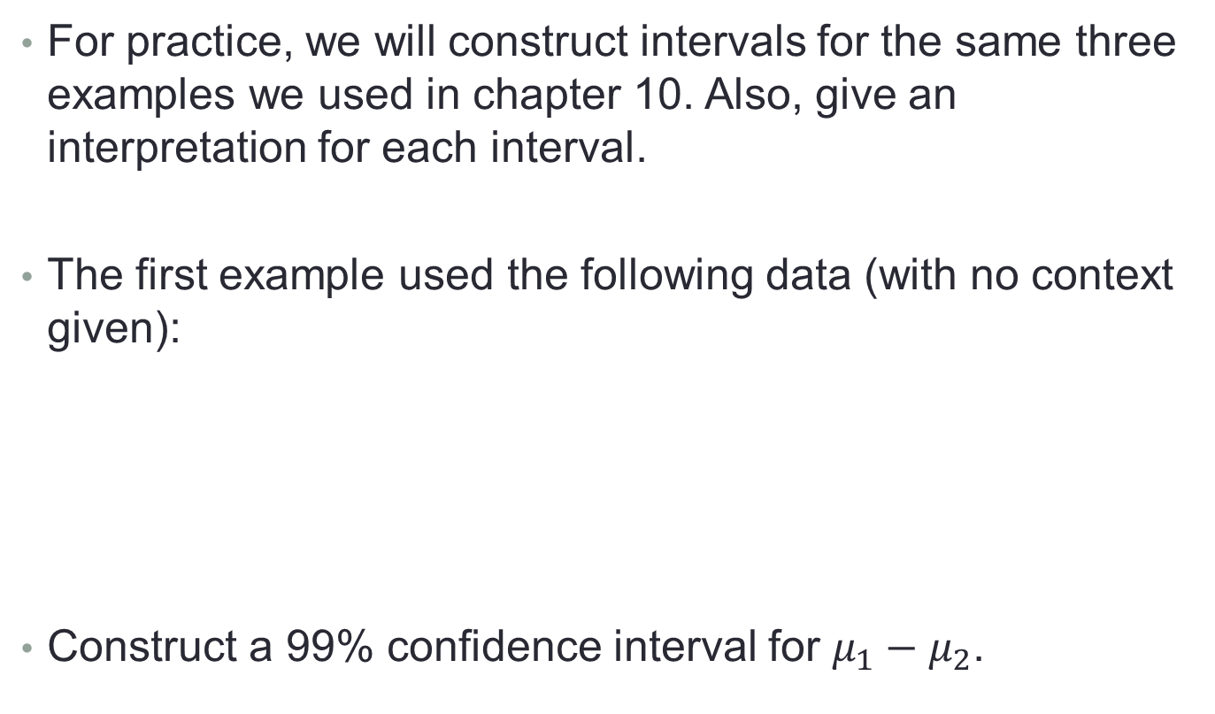
9.8 – Estimating the Difference between Two Means
For practice, we will construct intervals for the same three examples we used in chapter 10. Also, give an interpretation for each interval.
The first example used the following data (with no context given):
Construct a 99% confidence interval for $μ_{1}−μ_{2}$.

Slide 10
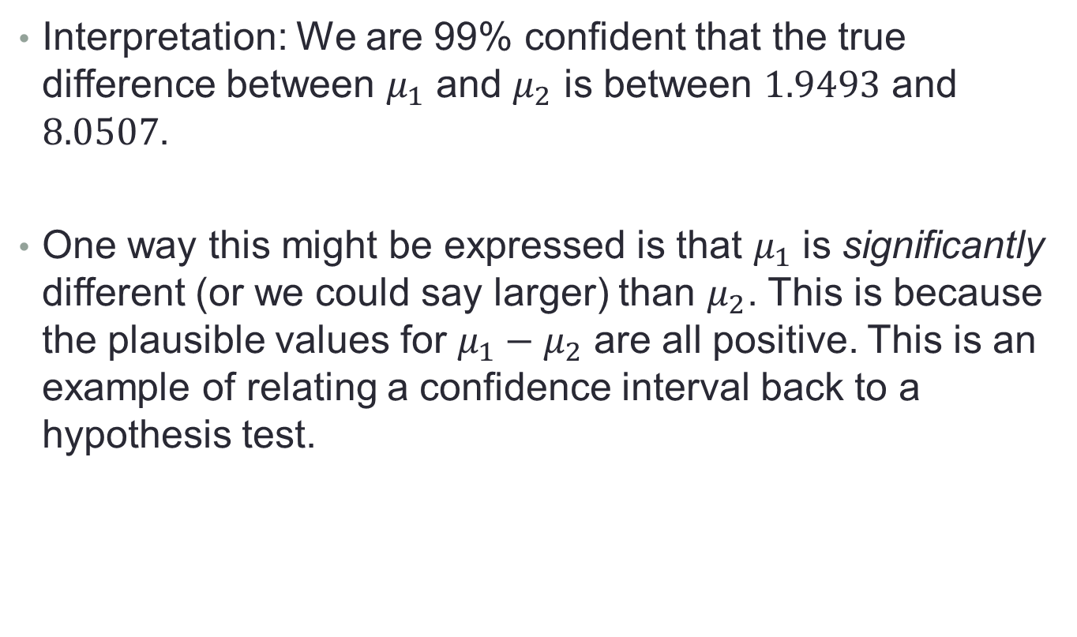
9.8 – Estimating the Difference between Two Means
Interpretation: We are 99% confident that the true difference between $μ_{1}$ and $μ_{2}$ is between $1.9493$ and $8.0507$.
One way this might be expressed is that $μ_{1}$ is significantly different (or we could say larger) than $μ_{2}$. This is because the plausible values for $μ_{1}−μ_{2}$ are all positive. This is an example of relating a confidence interval back to a hypothesis test.

Slide 11
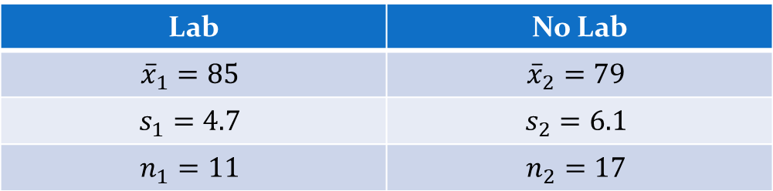
9.8 – Estimating the Difference between Two Means
Next we had the example comparing the scores of students in a physics class with a lab to scores of students in a physics class without a lab. Assuming equal variances, construct a 95% interval for the difference in the average score between students who took the lab and students who did not (note that this is a good replacement for having to do a lot of different hypothesis tests like we did in 10.5).

Slide 12
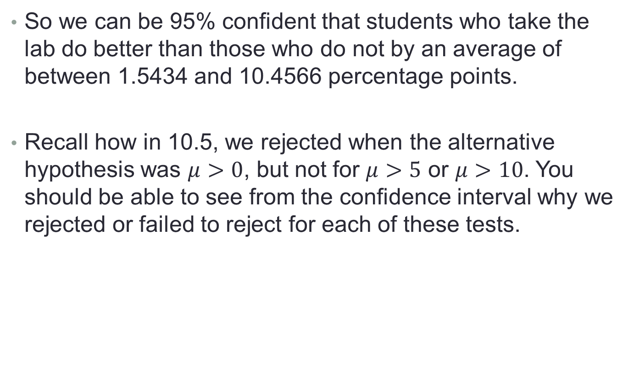
9.8 – Estimating the Difference between Two Means
So we can be 95% confident that students who take the lab do better than those who do not by an average of between 1.5434 and 10.4566 percentage points.
Recall how in 10.5, we rejected when the alternative hypothesis was $μ>0$, but not for $μ>5$ or $μ>10$. You should be able to see from the confidence interval why we rejected or failed to reject for each of these tests.

Slide 13
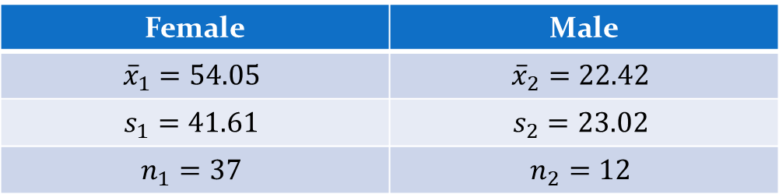
9.8 – Estimating the Difference between Two Means
Finally, we look again at the haircut example. Assuming unequal variances, construct a 90% interval for the difference in the mean cost of a haircut between women and men.

Slide 14
9.8 – Estimating the Difference between Two Means
Here we are 90% confident that, on average, women pay between $15.50 and $47.76 more for haircuts than men.

